Slide 1
Quality of Service (QoS)
IIT Kharagpur, Spring 2017
Amit Saha

Slide 2
Menu
Why QoS
IntServ
DiffServ
Policing and dropping
Queuing/Scheduling
Traffic Shaping
Active Queue Management (ECN)
Notes:
Voice call – 64 kbps
Voice delay (max) – 300 ms

Slide 3
References
Internet QoS – Architecture and Mechanisms for Quality of Service
Zhang Wang
Presentations available on the internet
QoS – Introduction to Quality of Service Concepts and Protocol – Peter R. Egli, Indigoo.com
Fundamentals of Quality of Service - Gopan Govindan
Quality of Service – Abhishek Wadhwa
QoS – Sri Safrina
Various documentation on the internet
Notes:
Voice call – 64 kbps
Voice delay (max) – 300 ms

Slide 4
Why QoS?
Reliability
Delay
Jitter
Bandwidth
As you increase the capacity of any system to accommodate user demand, user demand will increase to consume system capacity.
5 Gbps
A
10 Gbps
B
6 Gbps
Notes:
Voice call – 64 kbps
Voice delay (max) – 300 ms

Slide 5
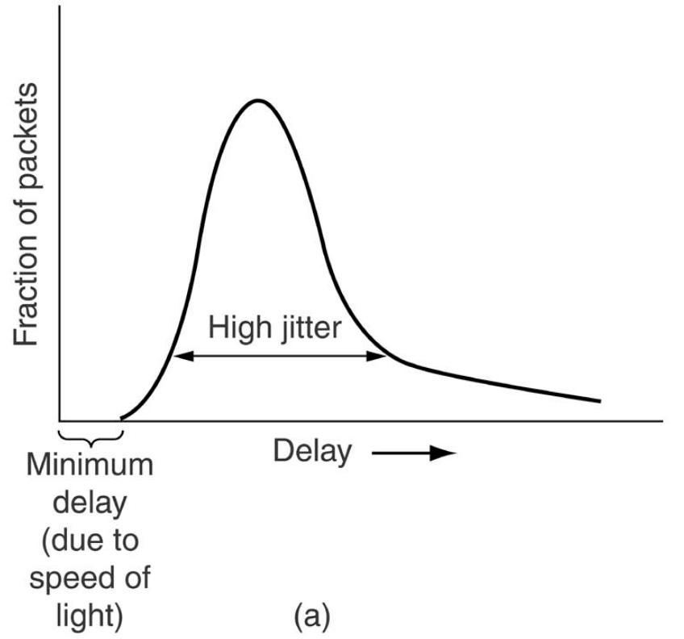
Average Delay
Maximum Delay
Delay Jitter

Slide 6
Departure at source
1
2
3
4
5
6
Arrival at destination
1
3
2
4
5
6
Play out at destination
1
2
3
4
5
6
Delay Offset

Slide 7
Application expectations
Latency and Fidelity (packet loss) – conflicting goals
Worst case delay = delay offset high fidelity but high latency!
Low delay Low latency but possibly low fidelity
Intolerant applications need absolute fidelity
Tolerant applications don’t need absolute fidelity

Slide 8
Integrated Services (IntServ)
Explicit resource reservation along entire path
Needs every intermediate node to conform
Entirely decoupled from route selection

Slide 9
QoS Routing Agent
Admission Control
Reservation Setup Agent
Resource Reservation Table
Control Plane
Flow Identification
Packet Scheduler
Data Plane

Slide 10
Reservation Setup (RSVP)
PATH Message
D1
S1
R1
R2
R3
R4
RESV message
D2

Slide 11
Admission Control
Allow new flow only if enough spare resources
Need to monitor resources
Parameter based
Difficult to specify exactly how much a flow will use
Reduced resource utilization
Measurement based
Statistical multiplexing
Improved resource utilization

Slide 12
Measurement based
New estimation = (1 – w) x old estimation + w x latest sample

Slide 13
Flow Identification
5 tuple is the most common way of identifying a flow
Per-packet flow identification for a large number of flows challenging at wire speed

Slide 14
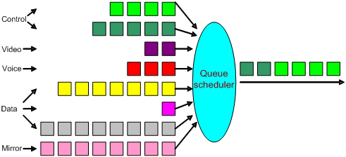
Packet Scheduler
Most important step!
Enforces resource allocation
Also known as Queuing

Slide 15
IntServ Services
Guaranteed Service
Controlled Load Service
But first,
Flow specification
Service specification

Slide 16
IntServ: Flow Specification
Peak rate
Average rate
Burst size – sustained insertion at peak rate
Maps to leaky bucket

Slide 17
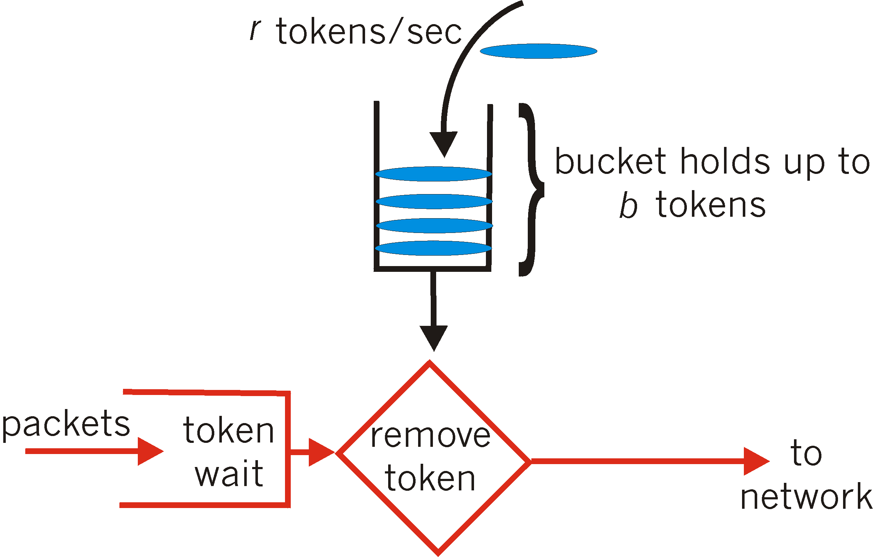
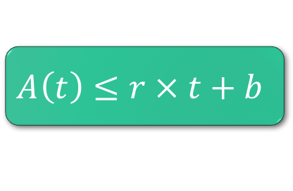
Leaky Bucket
$$A\left(t\right)≤r × t+b$$

Slide 18
Service Specification
Minimum bandwidth
Delay – average or worst case
Delay jitter
Loss rate

Slide 19
Guaranteed Service
TSpec
Bucket rate (r bytes/sec) – rate of token arrival
Peak rate (p bytes/sec) – peak rate of packet arrival
Bucket depth (b bytes)
Minimum policed unit (m bytes) – any packet less than ’m’ bytes is counted as ’m’ bytes
Maximum packet size (M bytes)
RSpec
Service rate (R bytes/sec)
Slack Term (S microseconds) – Extra delay that a node may add to still meet end-to-end delay requirements

Slide 20
Controlled Load Service
TSpec only – no RSpec
Bucket rate (r bytes/sec) – rate of token arrival
Peak rate (p bytes/sec) – peak rate of packet arrival
Bucket depth (b bytes)
Minimum policed unit (m bytes) – any packet less than ’m’ bytes is counted as ’m’ bytes
Maximum packet size (M bytes)

Slide 21
What if sender is lying?
Policing
Packets that do not conform to TSpec are treated as best effort and could be dropped
Shaping
Buffer packets to conform to TSpec by buffering.
Done in internal nodes and not at the edge

Slide 22

Packet Scheduling/Queuing
FIFO
Priority Queue

Slide 23
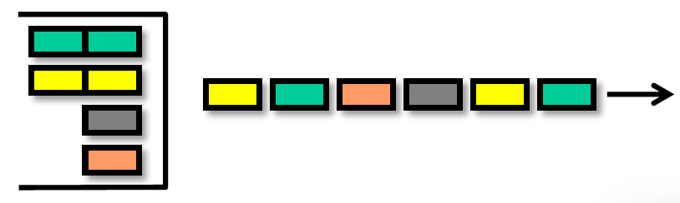
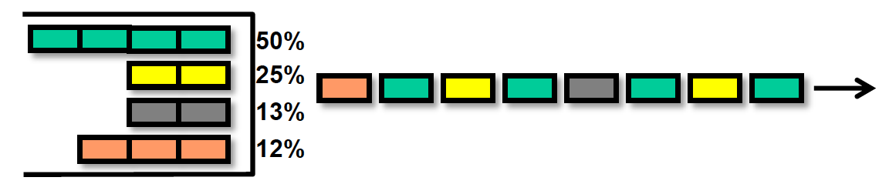
Queuing Techniques
Round Robin
Weighted Round Robin /
Class Based Queuing
Notes:
What happens if there are no tokens and packet arrives?

Slide 24
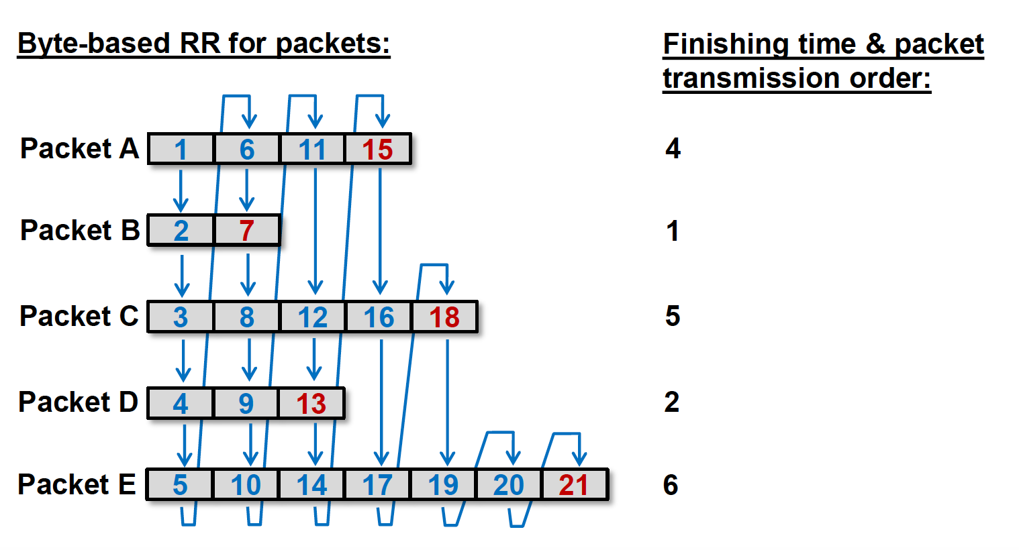
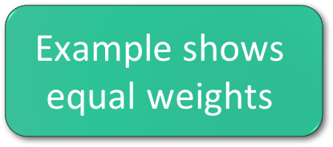
Weighted Fair Queuing
$$\text{Example} \text{shows}$$
$$\text{equal} \text{weights}$$

Slide 25
IntServ Problems
Suited for long lived flows
Video conferencing
Most web flows are short lived
All intermediate network elements/routers must support IntServ
Per-flow classification and scheduling
Authorization, authentication, and accounting of reservations “difficult”
Influenced DiifServ and MPLS

Slide 26
DiffServ
Classify traffic into forwarding classes (and loss priority) – individual flows do not matter
Define forwarding behavior, not services
No resource reservation setup
Admission control at edge of network

Slide 27
Forwarding Classes
Practically there is a many to one mapping from FC to Output Queues
Output port
FC1
FC2
FC3
FC4

Slide 28
Customer network
Customer network
Customer network
Customer network
Boundary node; classifies and marks forwarding classes
Interior node; looks at forwarding class only – not quite true in reality

Slide 29
Per-hop Behavior (PHB)
Externally observable forwarding treatment at a single node is PHB
All packets undergoing same PHB are called as a behavior aggregate

Slide 30
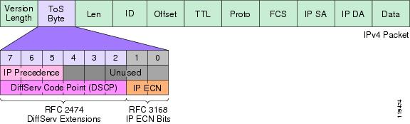
Differentiated Services Fields

Slide 31
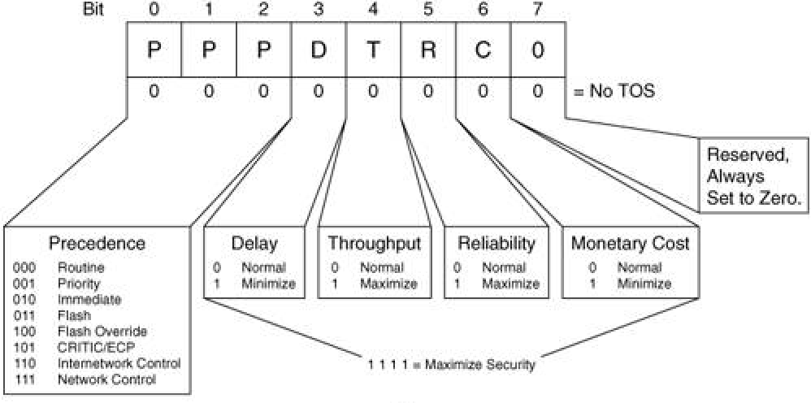
IP Precedence

Slide 32
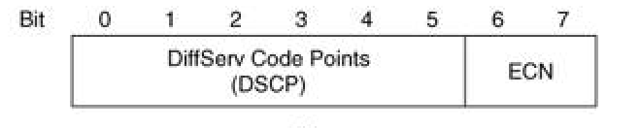
DSCP
Redefines the IP TOS field and tries to maintain some backward compatibility

Slide 33
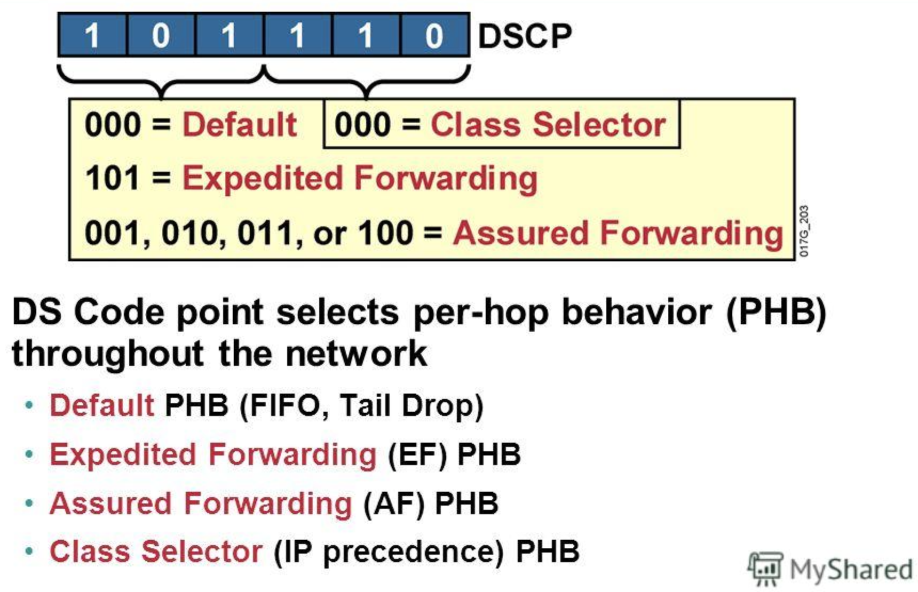

Slide 34
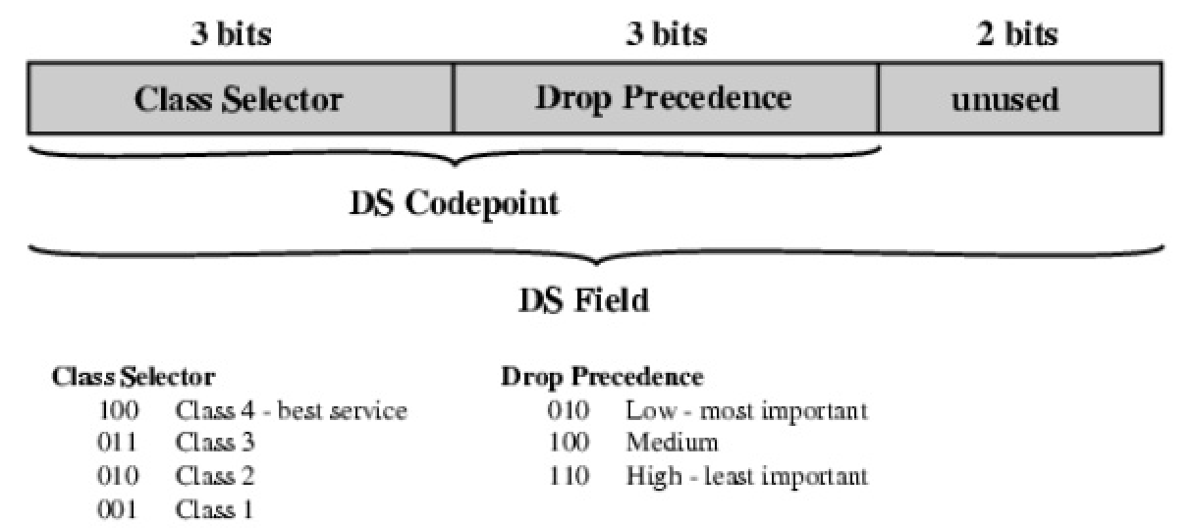
Assured Forwarding (AF) PHB Group
Four forwarding classes and 3 drop priorities within each FC.
Drop priorities are used to select which packets to drop during congestion

Slide 35
Example PHBs
Default PHB – RFC 2474 – DSCP 0 – traditional best-effort service (FIFO)
Class-selector PHB – RFC 2474 – backward compatibility with IP precedence – xxx000
Assured Forwarding PHB – RFC 2597 - 4 AF classes - AF1, AF2, AF3, AF4
Expedited Forwarding PHB – RFC 2598 – map to priority queue – DSCP 46

Slide 36
QoS at Boundary Node – The model
Remarker
Classifier
Marker
Meter
Shaper
Dropper
Classification
Conditioning

Slide 37
Classification at Boundary Node
Classifier
BA Classifier – Classify based on DSCP code point in packet
MultiField (MF) Classifier
Marker - actually sets the DSCP code point in the packet

Slide 38
Conditioning at Boundary Node
Meter
Token bucket
Dual Token Bucket
Marker – Change the DSCP or mark non conformant packets for further action
Shaper – Ensure that the customer traffic follows certain rates
Dropper/Policer – Easier to implement than shaping since shaping needs buffering

Slide 39
Traffic Policing
Dual Token Bucket for packet coloring
Also known as trTCM (Two-Rate Tri-Color Marker)
PIR: Peak Information Rate
PBS: Peak Burst Size
CIR: Committed Information Rate
CBS: Committed Burst Size

Slide 40
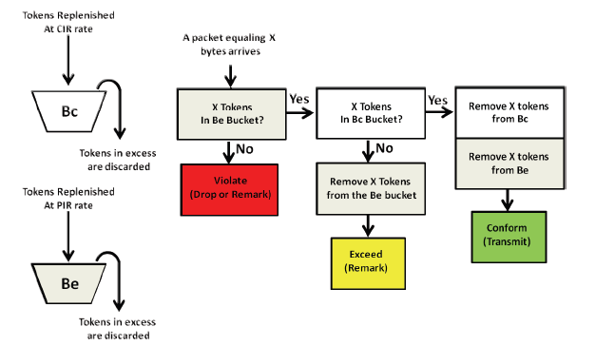
trTCM

Slide 41
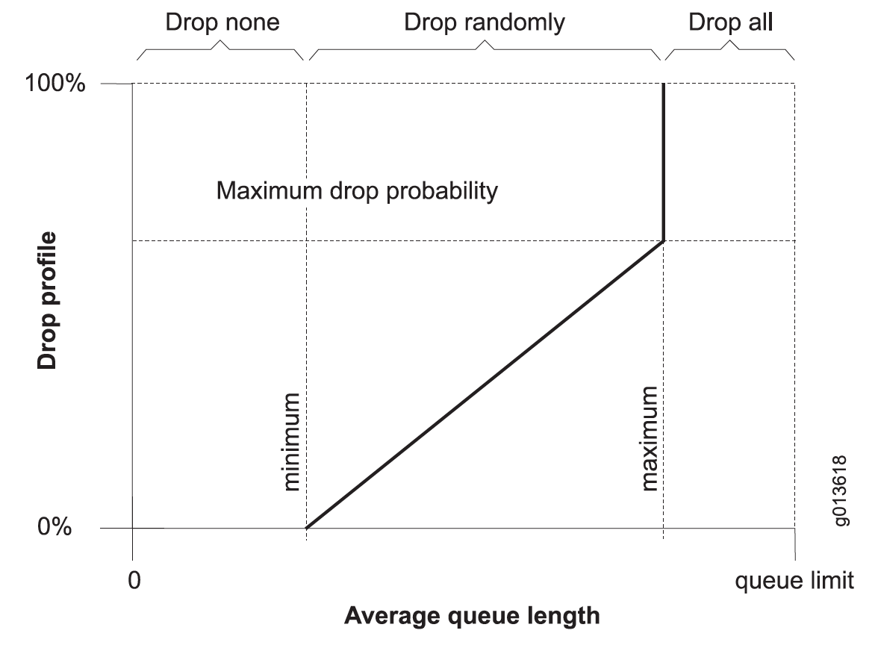
RED
/ Tail drop

Slide 42
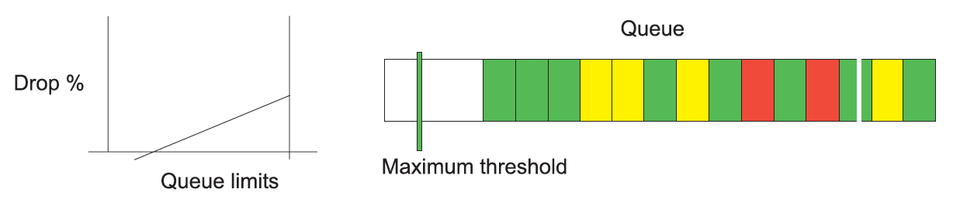
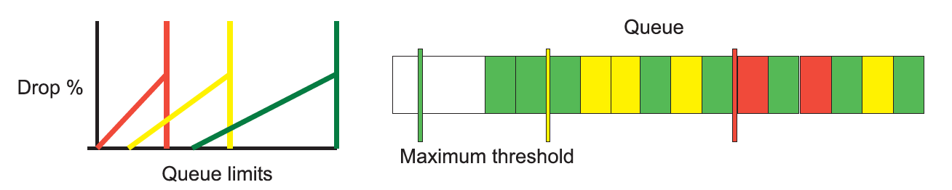
RED
WRED

Slide 43
Putting it all together

Slide 44
Ingress Port
FC LP
FC LP
red | yellow | green
Input port
Classifier
Policer
Switching/Routing
Store packet in memory meant for appropriate Q
Either BA or MF
Packet buffer for queues

Slide 45
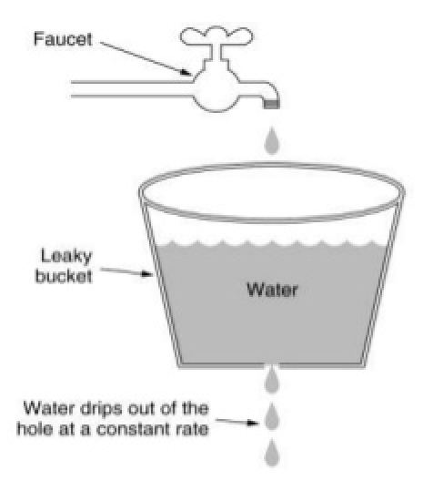
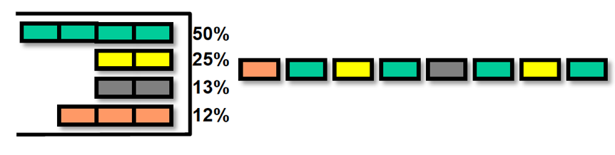
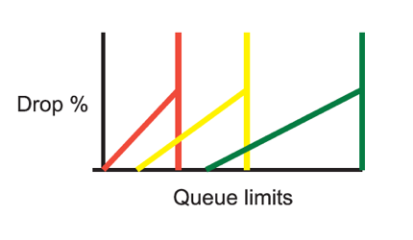
Egress Port
Output port
FC LP
Q1
Scheduler
Q2
Switching/Routing
Dropper
Shaper
Packet buffer for queues

